Slide 1
Machine Learning

Slide 2
Feature Selection
EDA showed there were some imbalanced features – ignored those
Manually chose features due to time – 9 in total
Only residential properties chosen to make representative
1 categorical feature so used one hot encoding
Made a `total bathrooms` feature
Only a few null values so dropped them
Min Max scaling was used
Log on price, living area and lot area as their distribution was skewed

Slide 3
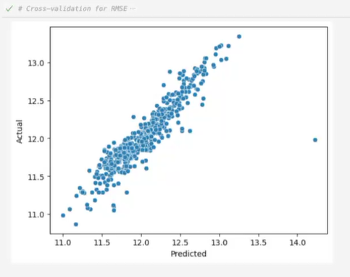
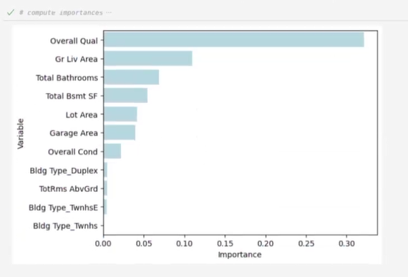
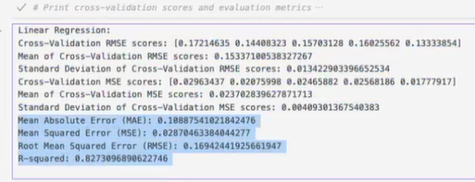
Linear Regression
Cross validation used to compare validation score to test score
Similar scores for both so model doesn’t underfit or overfit
Metrics used for evaluation: MSE, RMSE, MAE and R2
Outliers

Slide 4
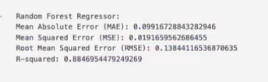
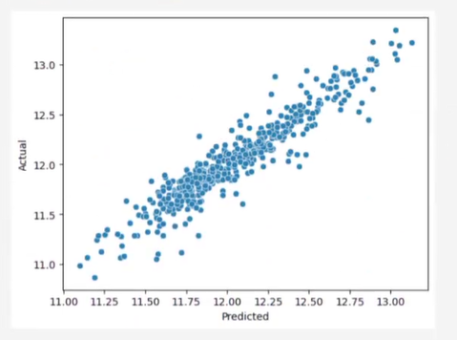
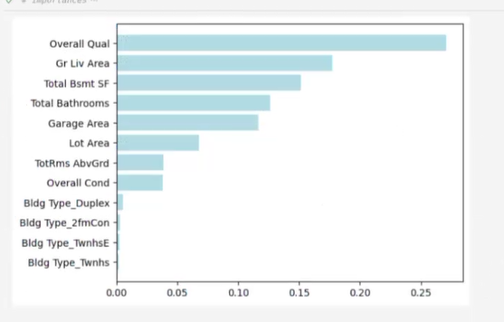
Random Forest
Hyperparameter tuning using grid search
The tuned HP were max depth, Num of estimators, max features, min samples leaf and min samples split
The metric used for gridsearch was R2. The R2 value for training data was similar to testing data so unlikely for there to be underfitting or overfitting
All the metrics this model performed better
Default param metrics were similar to the HP tuned

Slide 5
Limitations
Manually selected features may have left out some important ones
Outliers not removed during data cleaning
Log transform make results difficult to interpret
More complete grid search

